Slide 1
Role-Based Access Control (RBAC)
ACE Solutions Architecture Technical Team

Slide 2
RBAC: Role-Based Access Control
Admin
Admin
Account Admin
Role-Based Operator
Developers/Read Only
RBAC short video for better understanding
Role-Based Operator
Developers/Read Only
https://youtu.be/ZRGIDY5xVqU
Security
Transit
TGW
CloudWAN
Peering
Site2Cloud
VPN
Tools
Operations

Slide 3
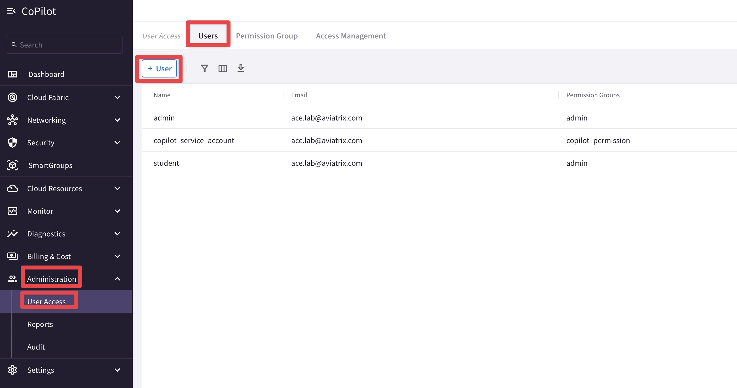
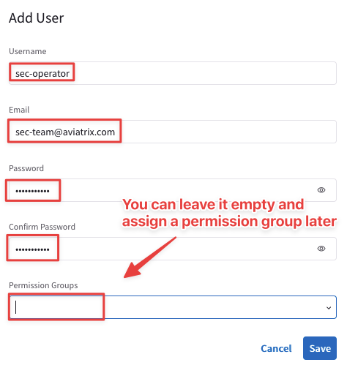
User Access- CoPilot

Slide 4
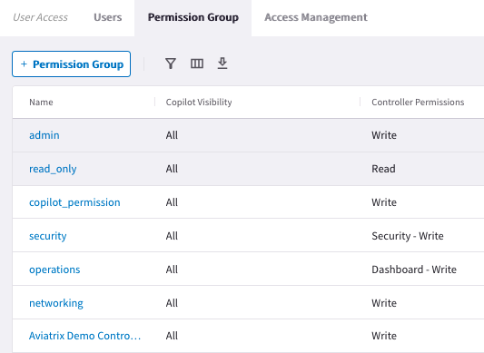
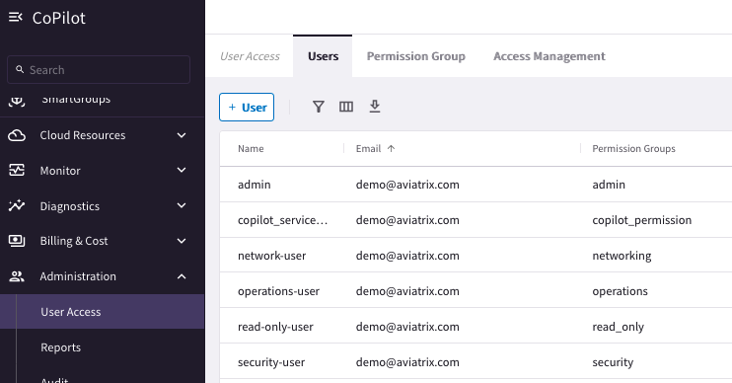
Aviatrix RBAC Control

Slide 5
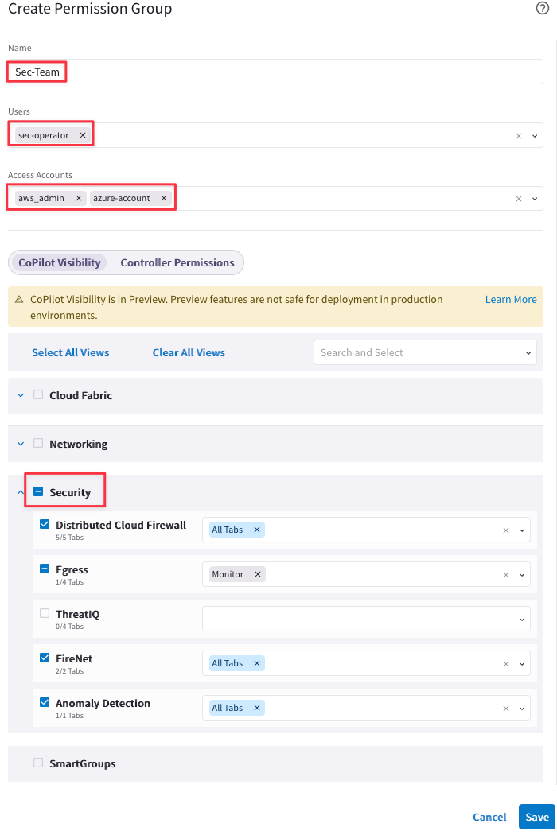
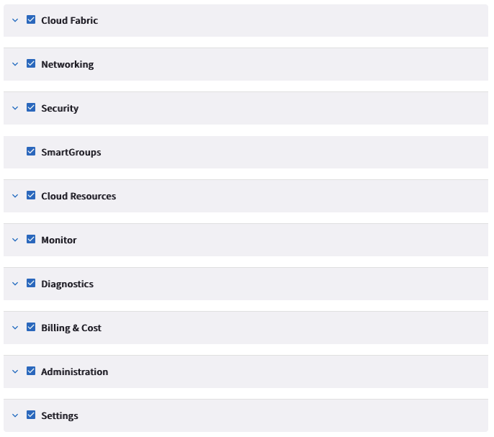
Permission Sets

Slide 6








Authentication Phase
Users can be authenticated:
Locally on the Aviatrix Controller
Onboard Users (Admin, Operators, Developers, Read-Only)
Allowed to reset their password
Using SAML IDP
Onboard Users (Admin, Operators, Developers, Read-Only)
Other functionality depends on IDP
AWS SSO

Slide 7
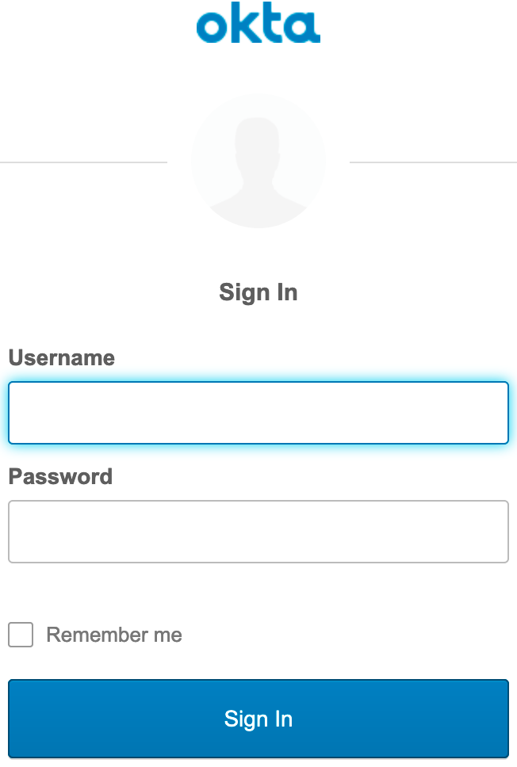
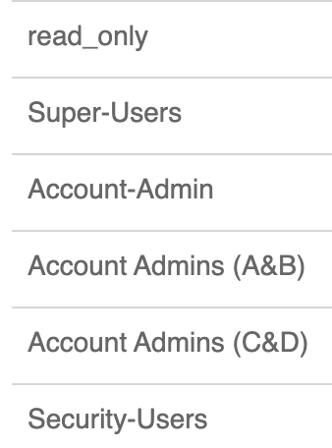
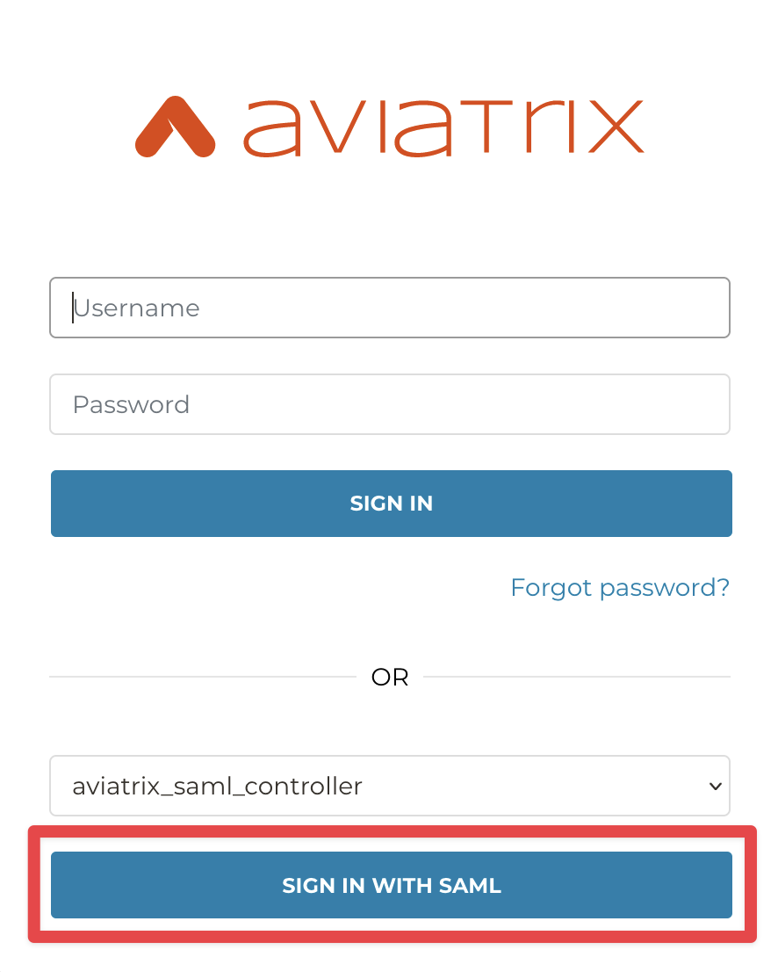
SAML Integration Example – Identity Provider
RBAC User: developer
RBAC User: Admin
RBAC User: Account_A-B
RBAC User: SecOps
RBAC-User | Permissions
developer | Read Only
Admin | Super User (Admin)
Account_A-B | CSP Account Admin for Accounts A&B Only
SecOps | Security User
Admin/Super-Users
Admin
Account Admins
Account-A&B
Security-User SecOps
Developers/Read Only
Developer

Slide 8
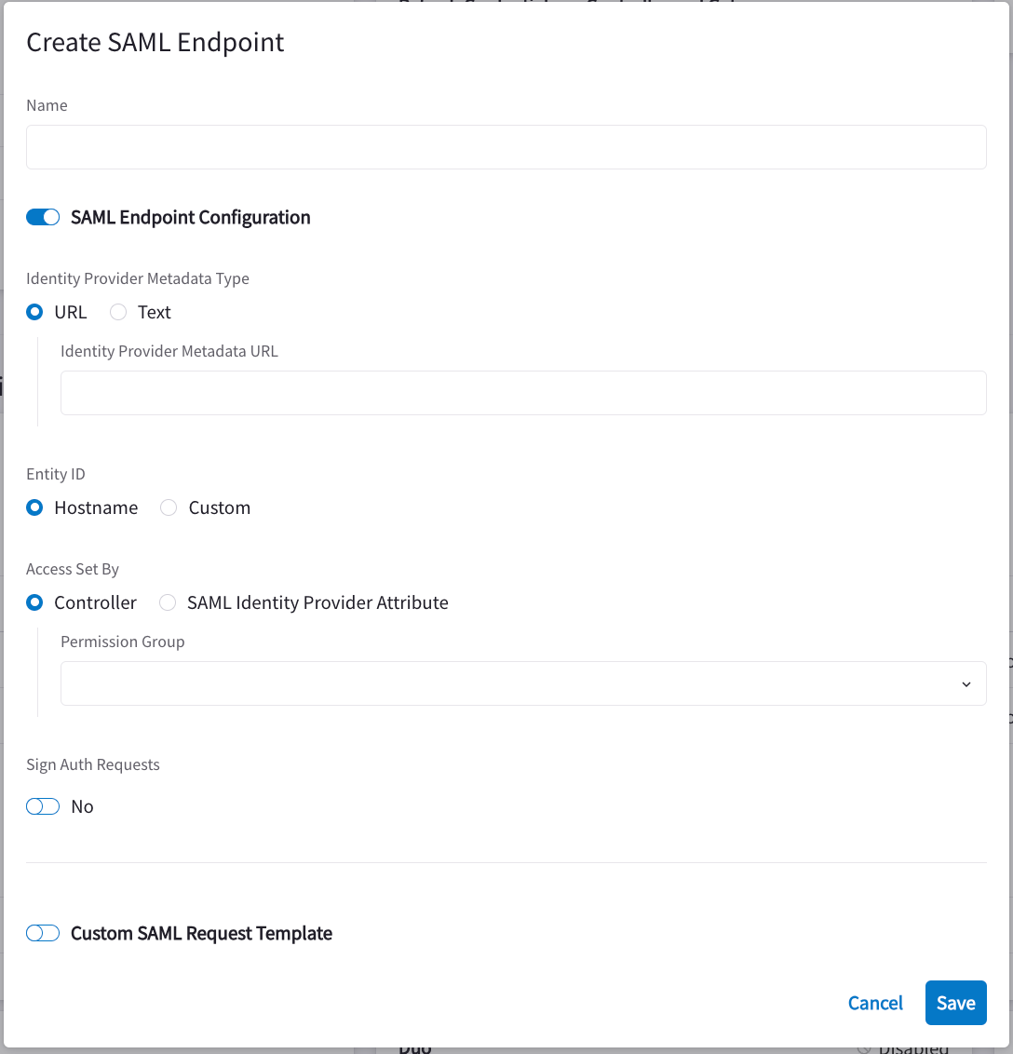
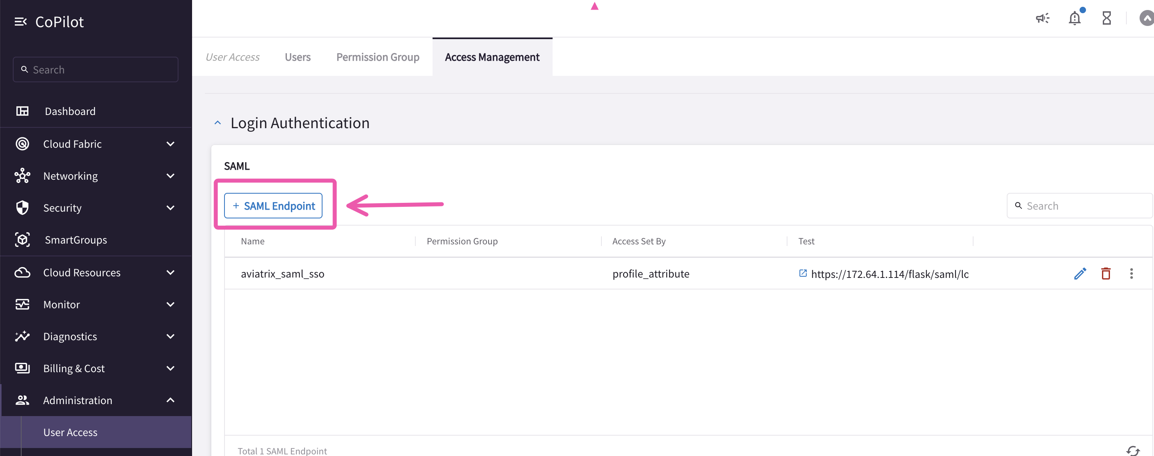
Configuring SAML Authentication:
Go to Administration > User Access > Access Management.
Under Login Authentication, click +SAML Endpoint.

Slide 9
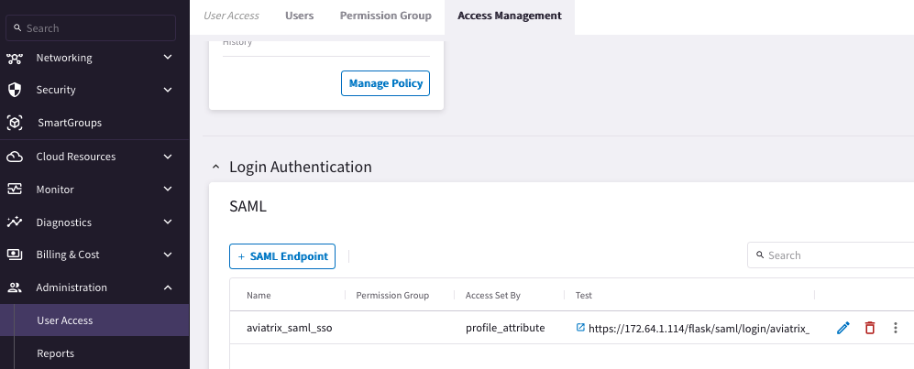
Authentication
Users can be authenticated Locally or using SAML IDP

Slide 10
Next: Lab 4 - RBAC

